Slide 1

Credit Card Transaction Analysis using Power BI
Insights into Spend by Card Type, Gender, Transaction volume by Card Type

Slide 2
Dataset Overview
Dataset Name: Credit Card Transaction
Source: Kaggle
Tools & Technologies
Power BI
Excel
Data cleaning & transformation

Slide 3
Key Business Requirement
1 Geographic Analysis
Which cities generate the highest total credit card spend?
Which cities have the highest average transaction value?
2 Customer Demographics
What is the spending split between male and female cardholders?
Which gender spends more in each expense category?
Are there city-specific gender spending patterns?
3 Card Type Analysis
Which card type (Gold/Silver/Platinum/Signature) records the highest transaction volume?
Which card type contributes most to total spend value?
Is there a correlation between card type and expense category?
4 Spending Category Analysis
What is the most common expense category across all transactions?
Which category drives the highest spend value?
How do expense preferences vary across cities?

Slide 4
Key Business Requirement
5.Time-Series Trends
What are the month-over-month and year-over-year spending trends?
Are there seasonal spikes (e.g., festivals, holidays)?
Which months record peak and lowest transaction volumes?

Slide 5
Key Performance Indicators (KPIs)
Total Transaction Value
Total Number of Transactions
Average Transaction Value
Top Spending City
Gender Spend Split (%)
Month-over-Month Growth
Top Expense Category
Card Type Share
City-wise Average Spend
Spend by Category & Gender

Slide 6
Dashboard Overview

Slide 7
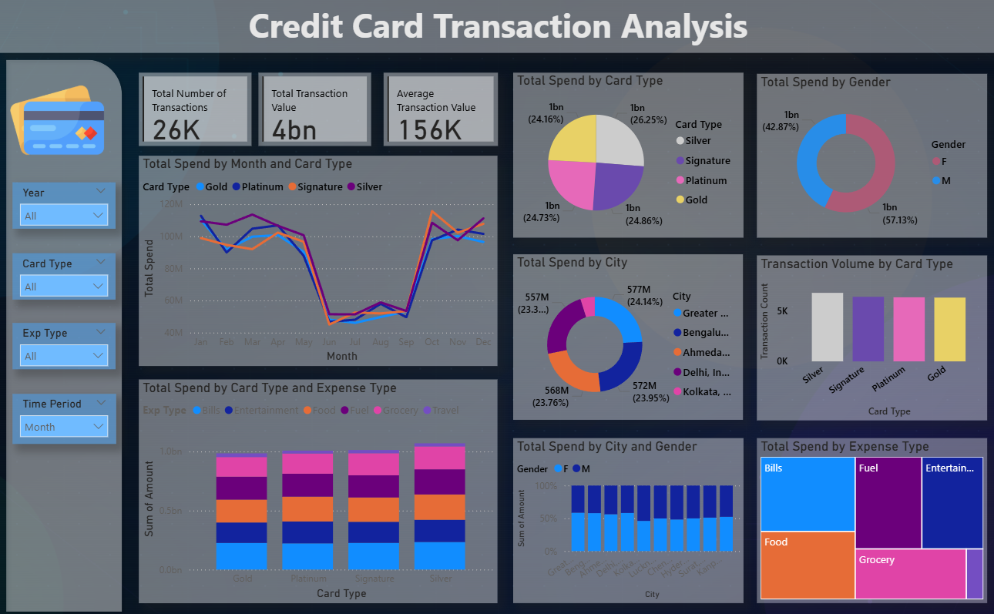

Slide 8
Inshights
1. Geographic Analysis
Top 5 Cities by Total Spend: Mumbai, Bengaluru, Ahmedabad, Delhi, and Kolkata.
Highest Average Transaction Value: Thodupuzha ($0.30M), Nahan ($0.27M), Alwar ($0.27M), Manendragarh ($0.25M), and Vellore ($0.25M).
2. Customer Demographics
Spend Distribution by Gender: Female cardholders contribute 57.13% of total spending, while males contribute 42.87%.
Category-wise Spending Split (% of Total Spend):
Expense Category | Female | Male
Bills | 14% | 8%
Entertainment | 9% | 9%
Food | 11% | 9%
Fuel | 10% | 10%
Grocery | 9% | 9%
Travel | 1% | 1%
Female cardholders spend more overall, particularly in Bills and Food, while spending patterns are similar across other categories.

Slide 9
3. Card Type Analysis
Highest Transaction Volume: Silver cards account for the largest share of transactions, contributing approximately 26.25% of the total transaction volume.
Highest Spending Card Type: Silver cards also contribute the highest share of total spending.
Relationship Between Card Type and Expense Category: Spending patterns are broadly consistent across all card types. Bills is among the highest spending categories, while Travel is the lowest across all card types. The category rankings remain similar, indicating no strong correlation between card type and expense category.
4. Spending Category Analysis
Highest Spending Category: Bills is the largest expense category, accounting for approximately 22% of total transaction value.

Slide 10
5. Time-Series Trends
Year-over-Year Spending Trends: Card spending experienced significant growth in 2014, reaching approximately $0.6 billion, an increase of $0.4 billion compared to the previous year. In 2015, spending declined to approximately $0.3 billion.
Seasonal Patterns: Transaction activity is noticeably lower between June and September, averaging around $50 million per month. During the remaining months, average spending is approximately $100 million per month.
Peak and Lowest Transaction Months:
Highest Transaction Volume: October
Lowest Transaction Volume: June
Key Insight
Card usage is dominated by Silver cards, Bills is the primary spending category, and spending exhibits a clear seasonal dip from June to September, with October recording the highest transaction activity.

Slide 11
Thank You

